Slide 1
CDN + Database Project
Team Members: Yani Jin, Xinyi Cai, Ryan Afranji

Slide 2
Content
System Structure
Implementation
Database
Web Server
Load Balancer
Proxy Cache
Q & A

Slide 3
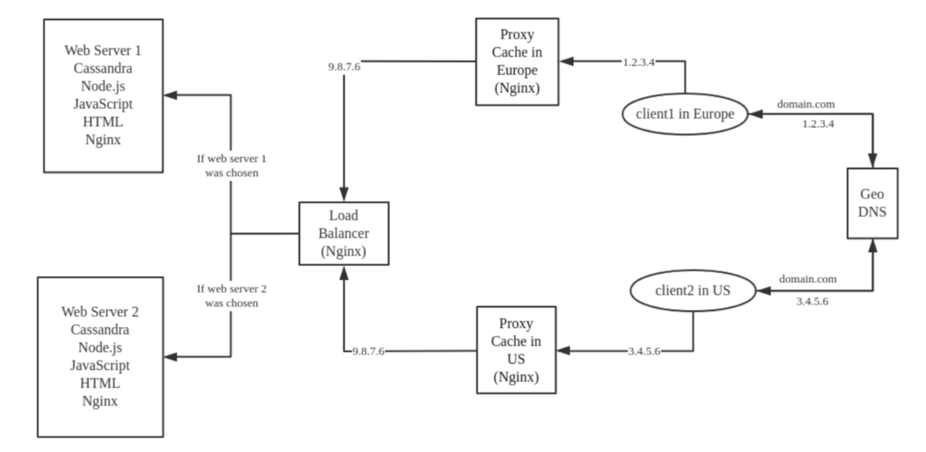
System Structure

Slide 4
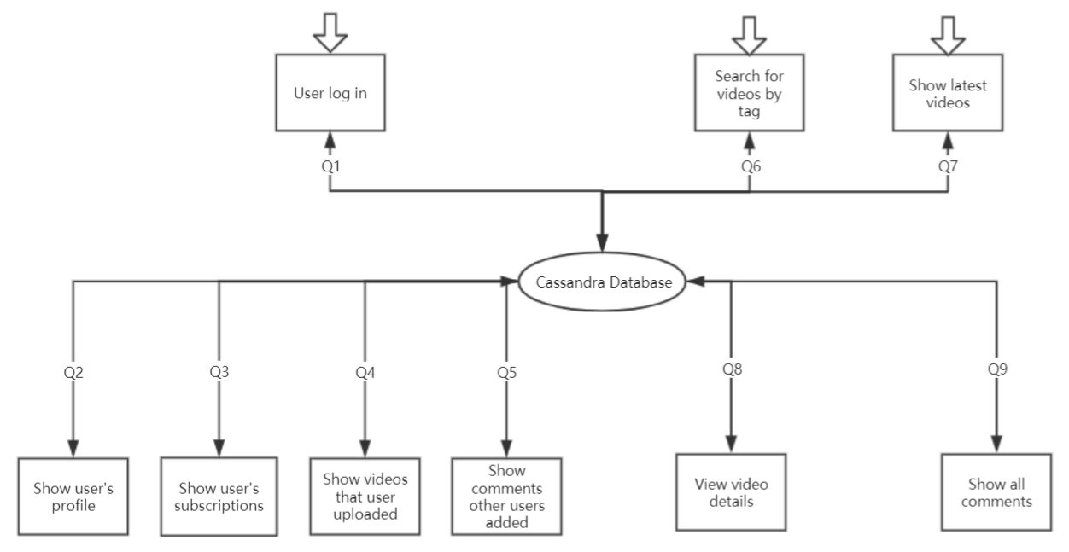
Database Design

Slide 5
Web Server
Cassandra runs as a process on local host

Slide 6
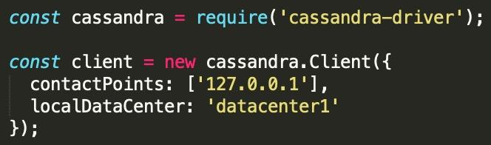
Web Server(cont.)
Node.js web server to support cassandra-driver

Slide 7
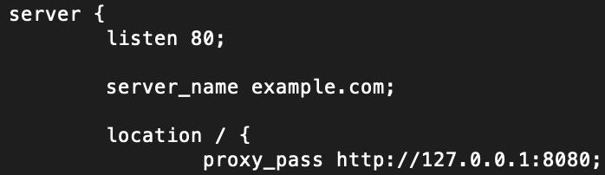
Web Server
Web server runs on local host on port 8080
Nginx conf -> routes local host web server to public ip

Slide 8
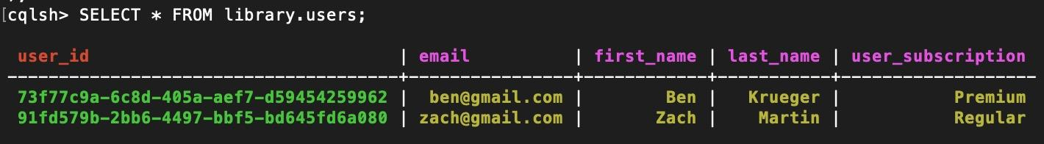
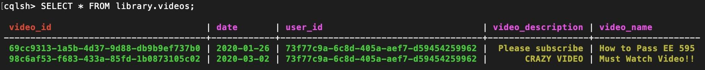
Web Server(cont.)
Samples from tables in the database

Slide 9
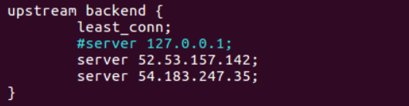
Load Balancer
Algorithm: Least connection
Upstream backend server IP address

Slide 10
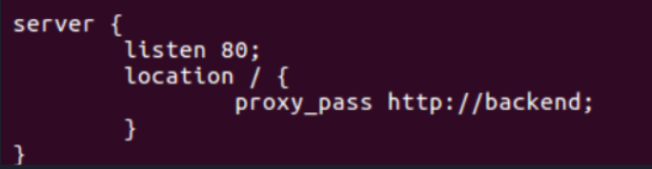
Load Balancer(cont.)
Listening port
Proxy path

Slide 11
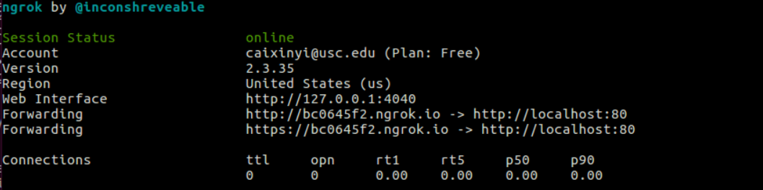
Load Balancer(cont.)

Slide 12
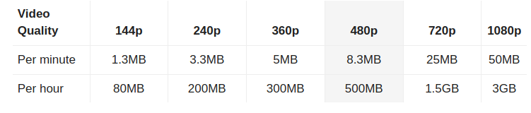
Proxy Cache
Set Path & Conf.
Location
Shared Memory Zone
Directory Hierarchy
Cache Size
Clear Timer
Disallow Temporary Storage

Slide 13

Proxy Cache (cont.)
Activate Shared Memory Zone
Set Valid Content and Duration
Refresh Content
When to use stale content

Slide 14
Q & A

